Slide 1
Unsupervised Learning on TCGA BRCA Gene Expression Using PCA and KMeans
Steven Wood
Machine Learning for Biology – Final Project
Dr. Toby

Slide 2
Objective
Explore structure in breast cancer gene expression using unsupervised learning
Visualization which revealed the presence of biological subtypes
Methods used:
PCA (dimensionality reduction)
KMeans clustering (grouping similar samples)

Slide 3
Dataset Overview
Dataset: TCGA BRCA gene expression dataset (Illumina HiSeq RNA-Seq)
The Cancer Genome Atlas Breast Invasive Carcinoma
Size: ~20,000 genes × 1,218 samples

Slide 4
Why this dataset?
Great for unsupervised learning because:
No labels
High Dimensionality
Biological Heterogeneity
Notes:
The dataset provides gene expression data only.
There are no predefined categories or classes.
~20,000 gene features per sample
PCA can be used to reduce this complexity while preserving structure
Perfect for techniques such as clustering, dimensionality reduction, and pattern discovery
Breast cancer isn’t just one disease. There are actually multiple molecular subtypes (Luminal A, Luminal B, HER2, Basal, etc.)
These subtypes are not obvious from raw expression alone
This is where unsupervised clustering comes in to uncover these patterns

Slide 5
Data Preprocessing
Due to memory constraints the first 1,000 genes were selected
Samples with missing values were removed
Values were standardized using StandardScaler

Slide 6
Methods used
Principal Component Analysis (PCA) reduced the dataset from 1,000 components to 2 components
Allowed for 2D visualization
KMeans Clustering
Used k=3 to create 3 clusters based on similarity in gene expression

Slide 7
Tools and Libraries used
Python 3.13.3 (Windows CMD)
Libraries:
Pandas
numpy
scikit-learn (PCA, KMeans)
Matplotlib
seaborn (visualization)
gzip (read compressed files)

Slide 8
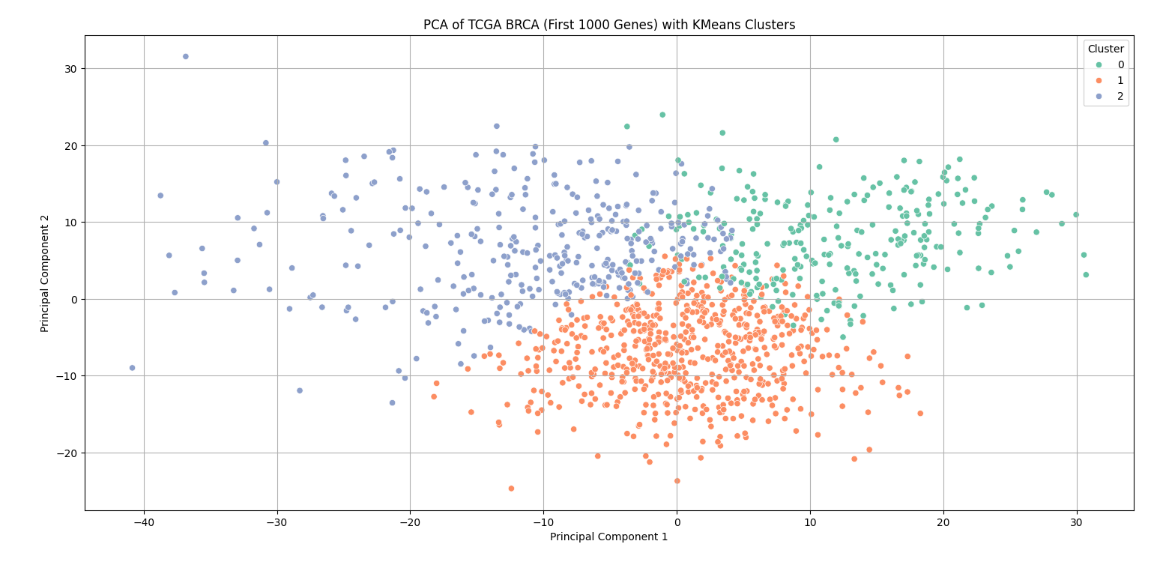
Visualization: PCA + KMeans Clusters
Notes:
This is the scatter plot produced. The 3 clusters suggest underlying biological subtypes. Biological subtypes are significant because they are genetically distinct forms of breast cancer that differ in their gene expression profiles and treatment methods.

Slide 9
Reproducibility
Download dataset from UCSC Xena: UCSC Xena
Open Windows CMD
Install libraries: pip install pandas numpy scikit-learn matplotlib seaborn
Open Python 3.13.3 in Windows CMD
Run Python script (adjust file path)
View PCA + KMeans plot

Slide 10
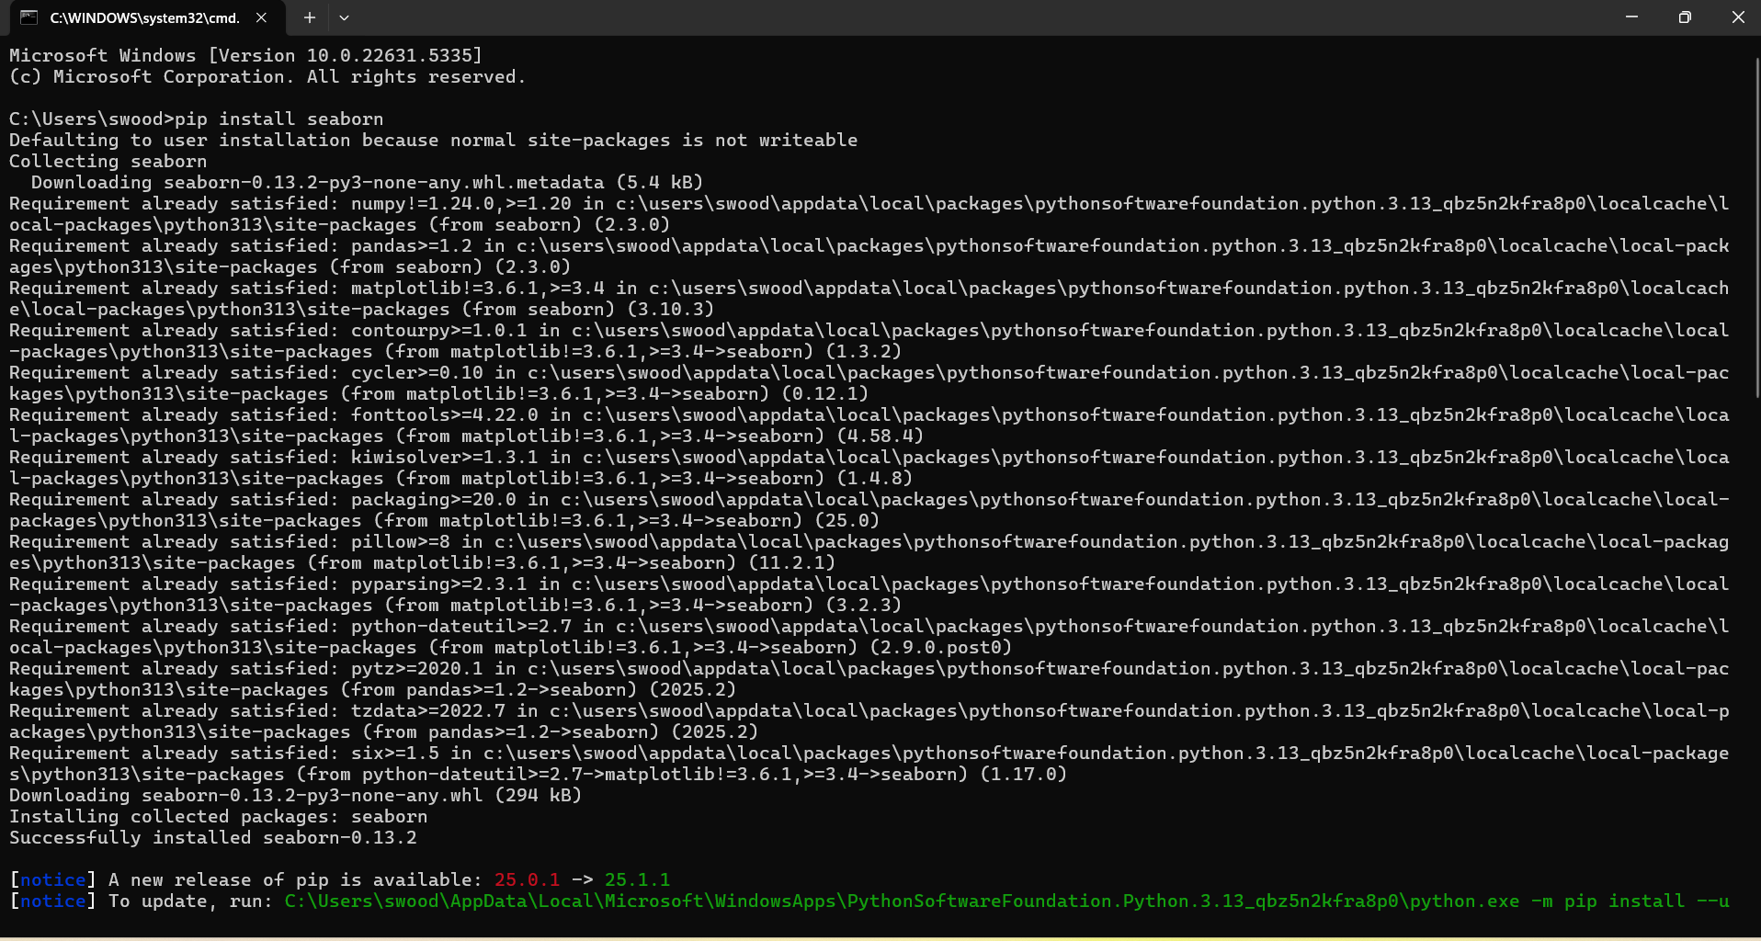

Slide 11
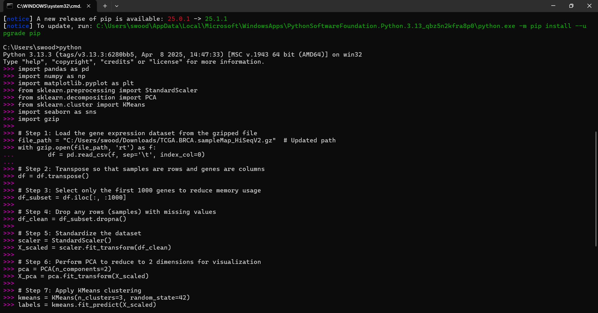

Slide 12
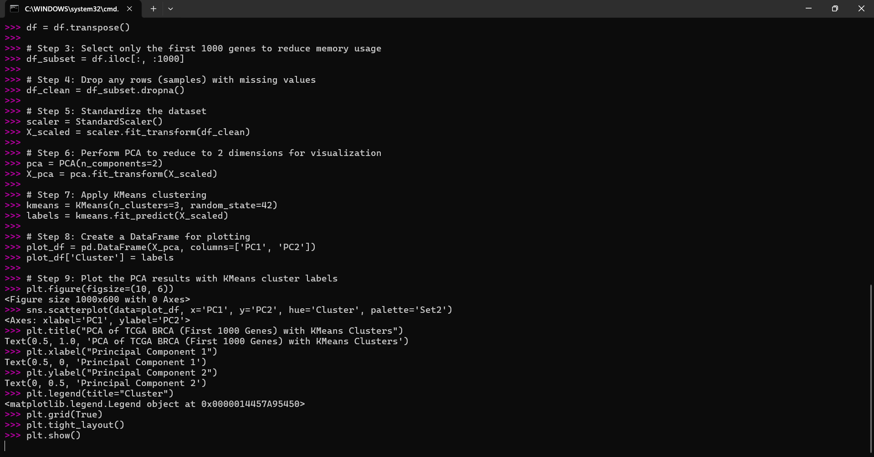

Slide 13
Critiques
Strengths:
Simple
Fast
Effective
Reproducible
Weaknesses:
KMeans assumes spherical clusters (biological data often is not spherical)
PCA has trouble with nonlinear patterns
Only the first 1,000 genes were used

Slide 14
Improvements
Use most informative genes instead of just the first 1,000
Use nonlinear methods such as: t-SNE, UMAP, and DBSCAN

Slide 15
Conclusion
Unsupervised learning successfully and efficiently revealed structure in breast cancer samples.
The clusters shown on the scatter plot suggest the presence of biological subtypes

Slide 16
Questions?
Thank you

